Slide 1
Introduction to the Embedded Systems

Slide 2
Embedded Systems:
An embedded system is some combination of computer hardware and software, either fixed in capability or programmable, that is designed for a specific function or for specific functions within a larger system. Industrial machines, agricultural and process industry devices, automobiles, medical equipment, cameras, household appliances, airplanes, vending machines and toys as well as mobile devices are all possible locations for an embedded system.

Slide 3
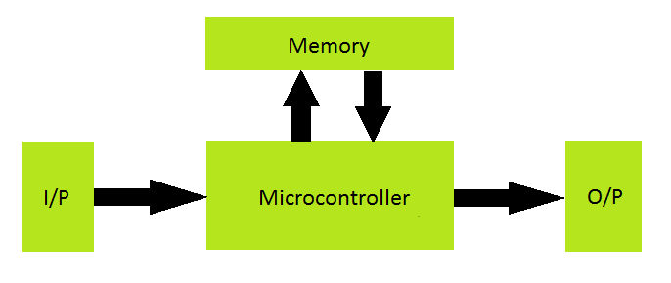
Block of Embedded Systems:

Slide 4
Applications:
Household appliances: Microwave ovens, Television, DVD Players & Recorders
Audio players
Integrated systems in aircrafts and missiles
Cellular telephones
Electric and Electronic Motor controllers
Engine controllers in automobiles
Calculators
Medical equipments
Videogames
Digital musical instruments, etc.

Slide 5
Advantages:
User friendly
Easily understandable and Handled.
Fully Automation.
Low Cost
Low Power Consumption

Slide 6
Micro Processor(µp) v/s Micro Controller(µc)
Microprocessor
CPU on a chip.
we can attach required amount of ROM, RAM and I/O ports.
Expansive due to external peripherals.
Large in size
general-purpose
Microcontroller
Computer on a chip
fix amount of on-chip ROM, RAM, I/O ports
Low cost.
Compact in size.
Specific -purpose.

Slide 7
Micro Processor:
General-purpose microprocessor
CPU for Computers
No RAM, ROM, I/O on CPU chip itself
Example：Intel’s x86, Motorola’s 680x0
Data Bus
CPU
General-Purpose Micro-processor
Serial COM Port
RAM
ROM
I/O Port
Timer
Address Bus
General-Purpose Microprocessor System

Slide 8
Micro Controller:
A smaller computer
On-chip RAM, ROM, I/O ports...
Example：Motorola’s 6811, Intel’s 8051, Zilog’s Z8 and PIC 16X
CPU
RAM
ROM
A single chip
Serial COM Port
I/O Port
Timer
Microcontroller

Slide 9
Introduction to the Arduino
The Arduino microcontroller is an easy to use yet powerful single board computer that has gained considerable traction in the hobby and professional market. The Arduino is open-source, which means hardware is reasonably priced and development software is free.
The Arduino programming language is a simplified version of C/C++. If you know C, programming the Arduino will be familiar. If you do not know C, no need to worry as only a few commands are needed to perform useful functions.
An important feature of the Arduino is that you can create a control program on the host PC, download it to the Arduino and it will run automatically.

Slide 10
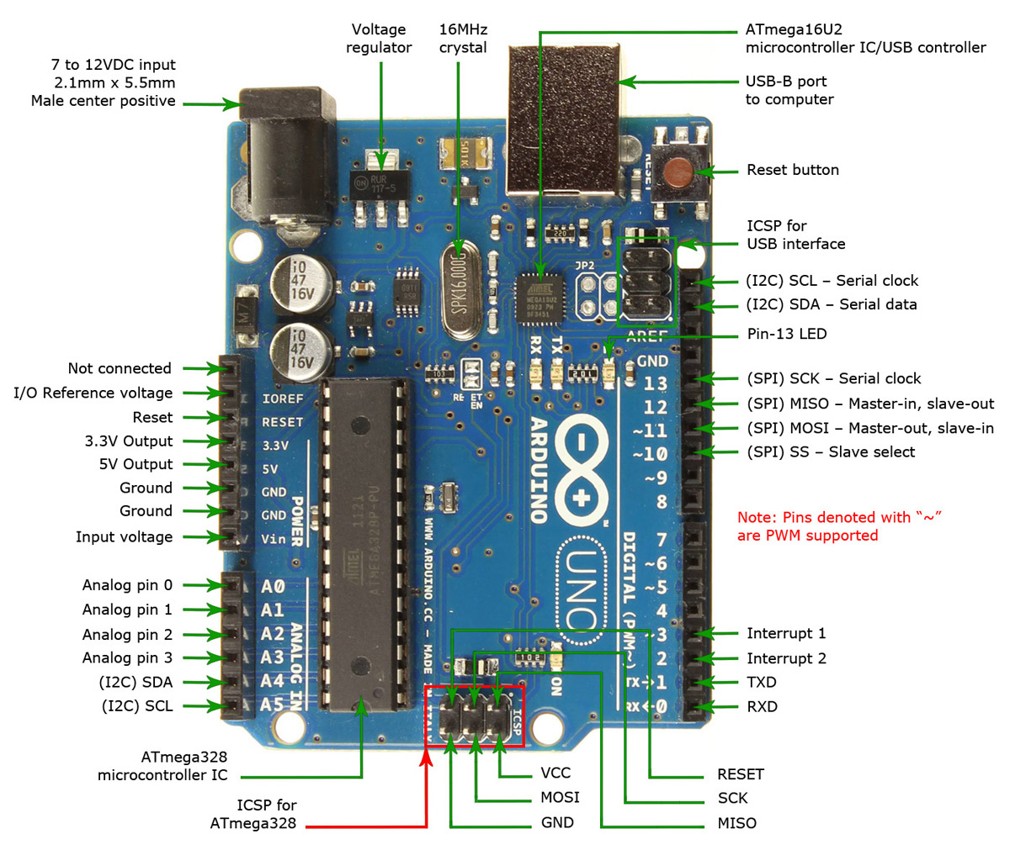
Arduino Board Overview Explanation

Slide 11
Introduction to the I/O programs
const int led = 13; //use digital I/O pin 13 void setup()
{
pinMode(led,OUTPUT); //set pin 13 to be an output output
}
void loop()
{
delay(1000); //delay 1000 milliseconds
digitalWrite(led,HIGH); //set pin 13 HIGH, turning on LED
delay(1000); //delay 1000milliseconds
digitalWrite(led,LOW); //set pin 13 LOW, turning off LED
}

Slide 12
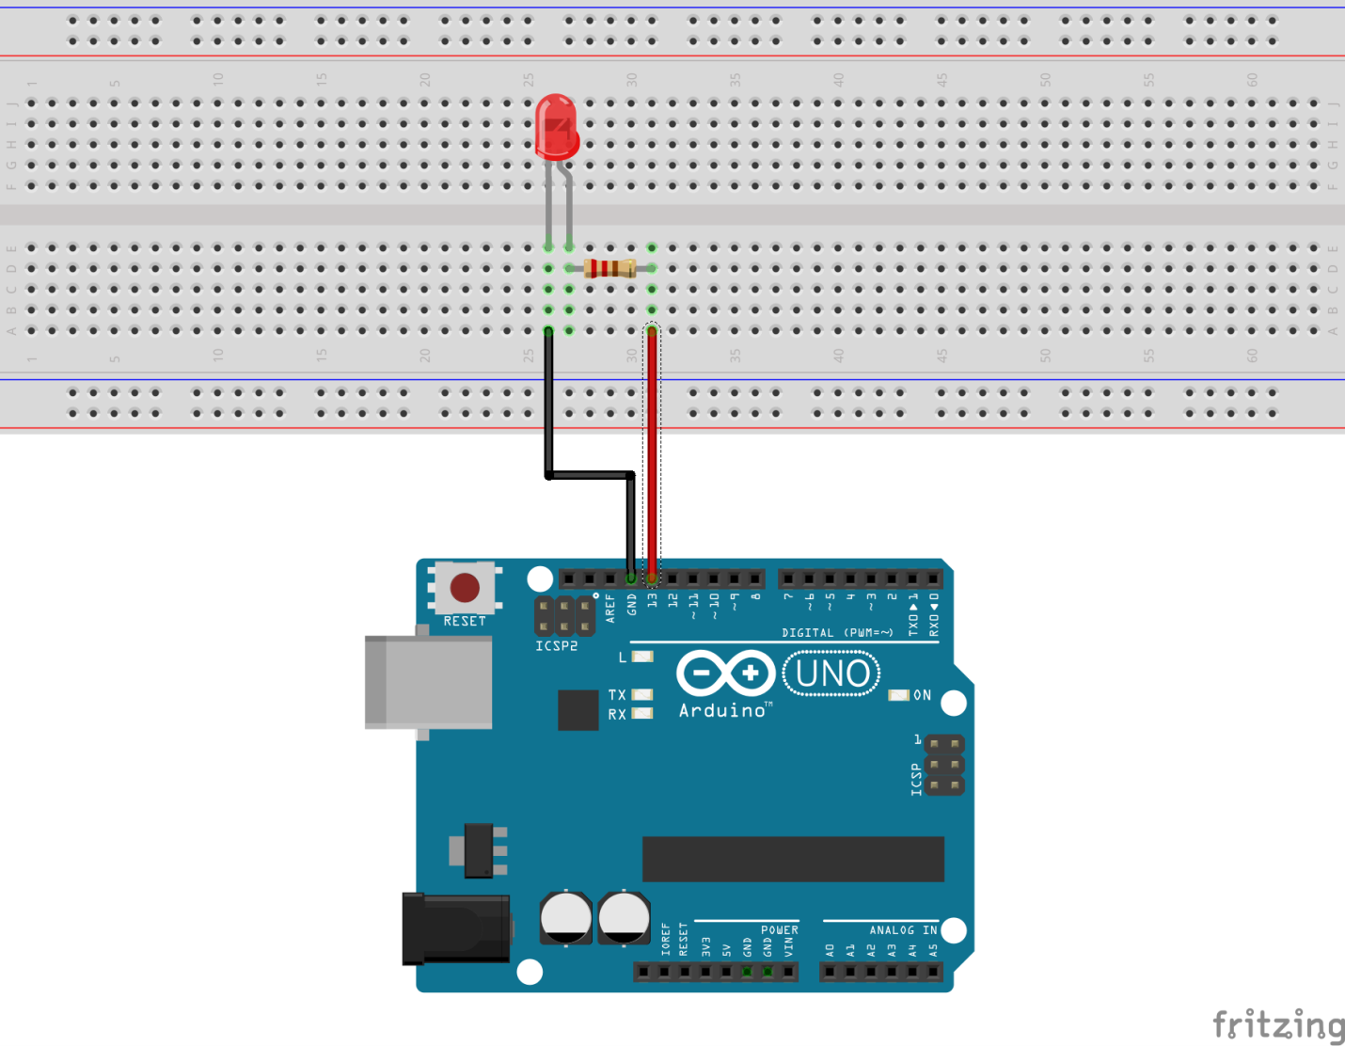

Slide 13
Interfacing led with Switch
const int led = 13; //name pin 8 as led const
int button = 9; //name pin 9 as button
void setup()
{
pinMode(led,OUTPUT); //set pin 13 as OUTPUT
pinMode(button,INPUT) ; //set pin 9 as INPUT
}
void loop()
{
int reads = digitalRead(button); //read the digital value on pin 9
digitalWrite(led,reads); //set the digital output value of pin 8 to that value
}

Slide 14
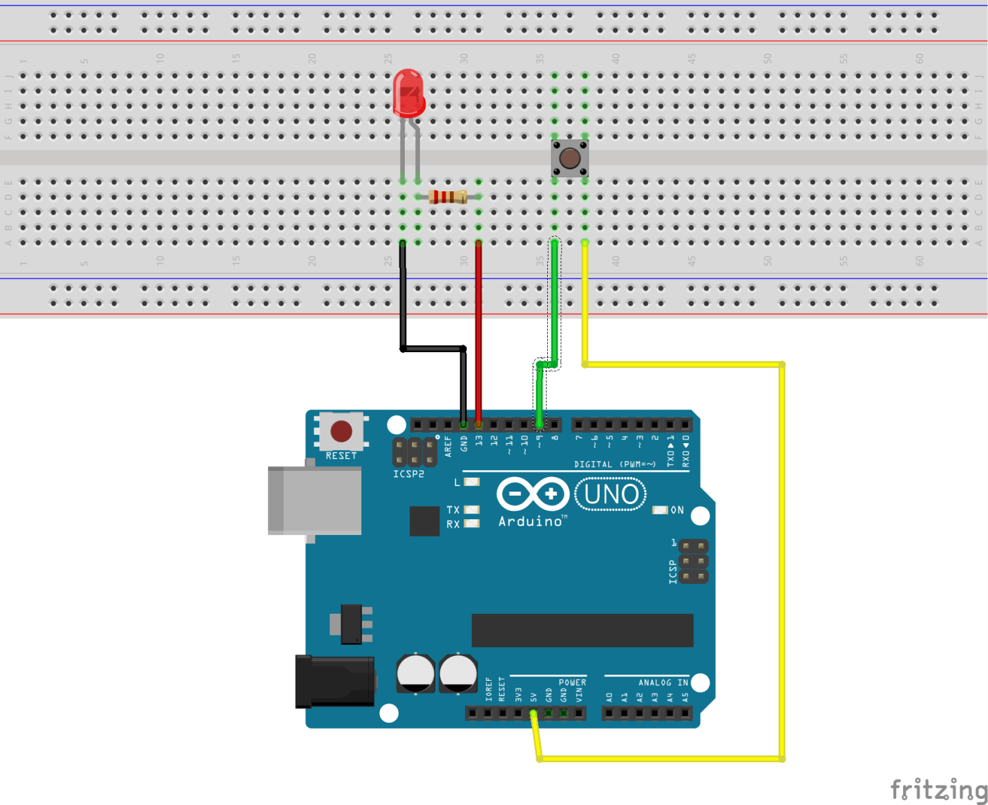

Slide 15
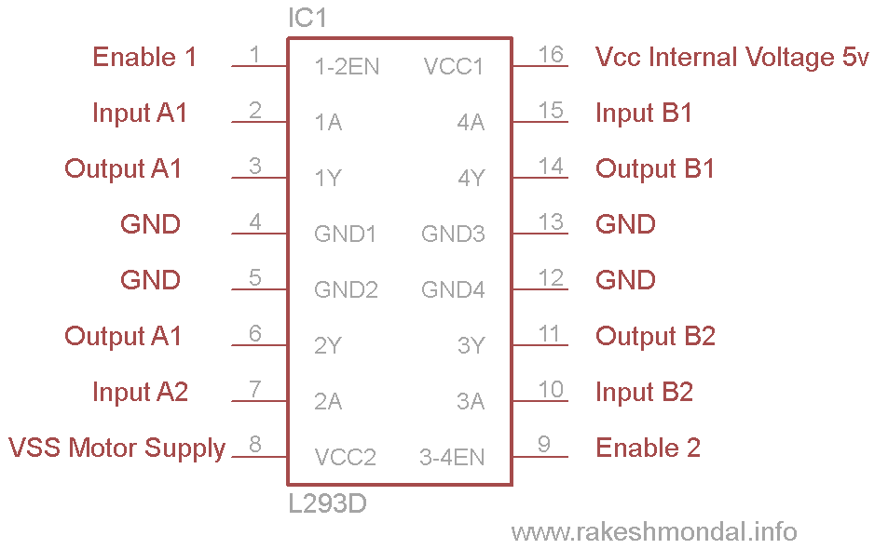
Introduction to the Motor Driver
L293D is a typical Motor driver or Motor Driver IC which allows DC motor to drive on either direction. L293D is a 16-pin IC which can control a set of two DC motors simultaneously in any direction. It means that you can control two DC motor with a single L293D IC. Dual H-bridge Motor Driver integrated circuit (IC).

Slide 16
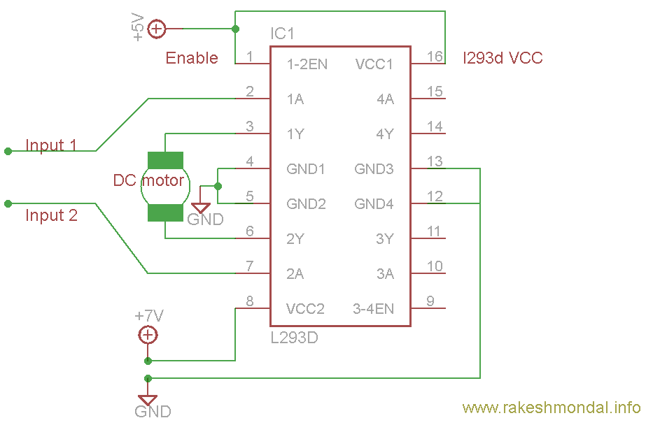
Working of Motor driver
There are 4 input pins for l293d, pin 2,7 on the left and pin 15 ,10 on the right as shown on the pin diagram. Left input pins will regulate the rotation of motor connected across left side and right input for motor on the right hand side. The motors are rotated on the basis of the inputs provided across the input pins as LOGIC 0 or LOGIC 1.

Slide 17
Interfacing Motor Driver with Switch
Void loop()
{
Sw=digitalRead();
If(sw==1)
{
digitalWrite(motorPin1,HIGH);
digitalWrite(motorPin2,LOW);
digitalWrite(motorPin3,HIGH);
digitalWrite(motorPin4,LOW);
}
Else
{
digitalWrite(motorPin1,LOW);
digitalWrite(motorPin2,LOW);
digitalWrite(motorPin3,LOW);
digitalWrite(motorPin4,LOW);
}
const int motorPin1 = 5; // Pin 14 of L293
const int motorPin2 = 6; // Pin 10 of L293
const int motorPin3 = 10; // Pin 7 of L293
const int motorPin4 = 9; // Pin 2 of L293
Int sw=2;
void setup()
{
pinMode(motorPin1, OUTPUT); //Set pins as outputs
pinMode(motorPin2, OUTPUT);
pinMode(motorPin3, OUTPUT);
pinMode(motorPin4, OUTPUT);
pinMode(sw,INPUT);
}

Slide 18
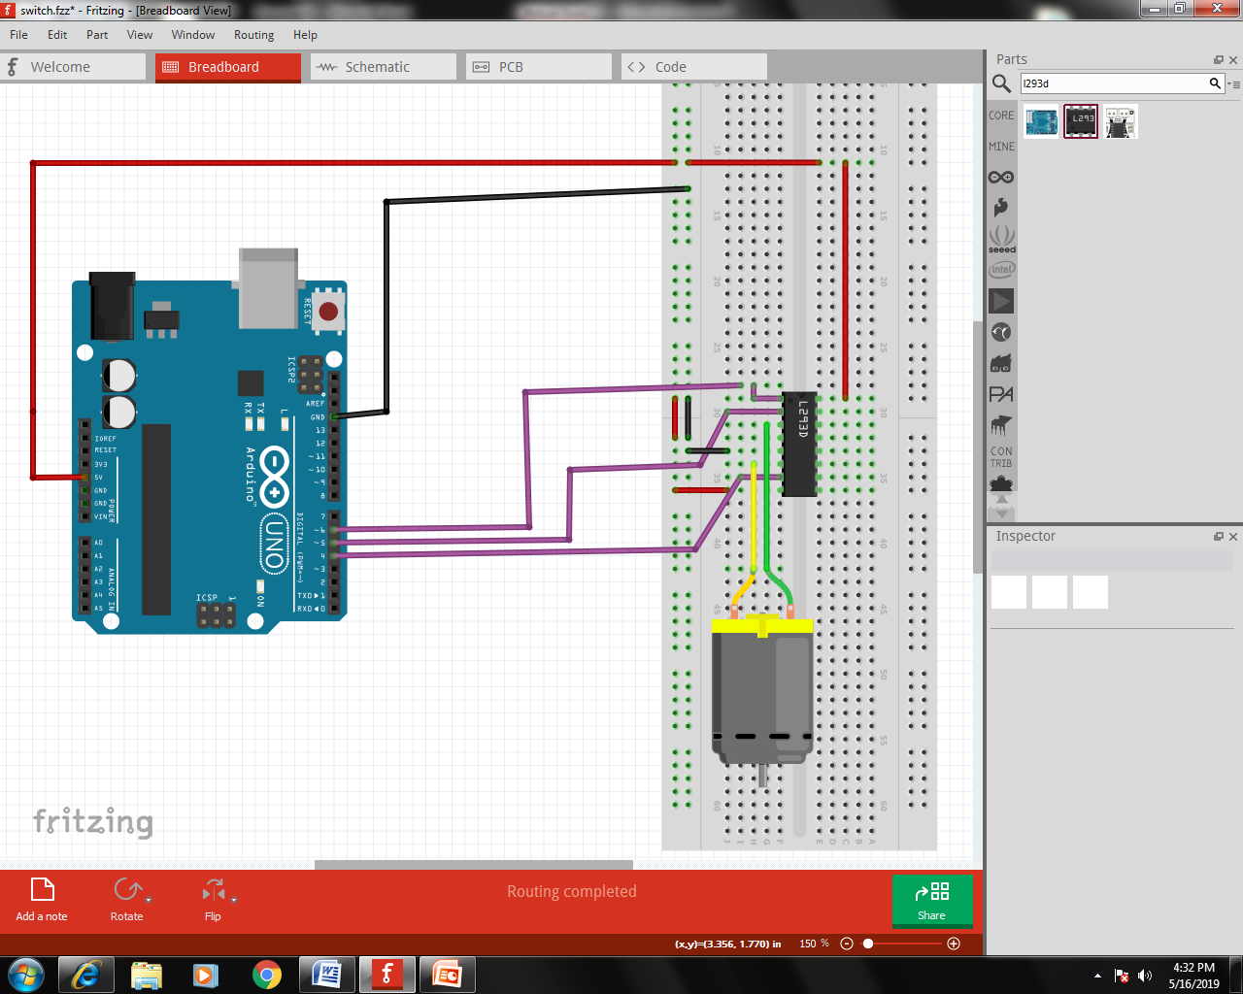

Slide 19
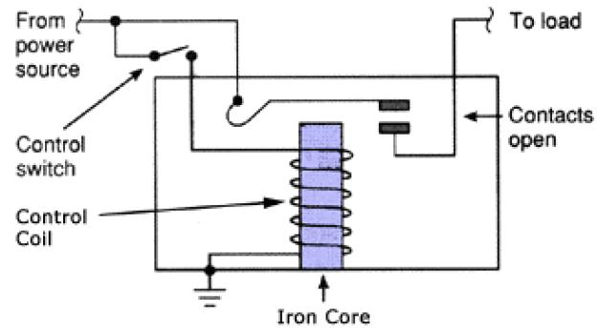
Introduction to the Relay
Relays are simple switches which are operated both electrically and mechanically. Relays consist of a n electromagnet and also a set of contacts. The switching mechanism is carried out with the help of the electromagnet.
The main operation of a relay comes in places where only a low-power signal can be used to control a circuit. It is also used in places where only one signal can be used to control a lot of circuits.
They were used to switch the signal coming from one source to another destination. After the invention of computers they were also used to perform Boolean and other logical operations. The high end applications of relays require high power to be driven by electric motors and so on. Such relays are called contactors.

Slide 20
Introduction to the Sensors
A sensor is a device that detects and responds to some type of input from the physical environment. The specific input could be light, heat, motion, moisture, pressure, or any one of a great number of other environmental phenomena. The output is generally a signal that is converted to human-readable display at the sensor location or transmitted electronically over a network for reading or further processing.
Some of the Examples of the Sensors:
IR Sensor
Temperature Sensor
Humidity Sensor
Gas Sensor…etc;

Slide 21
Interfacing IR Sensor with Buzzer
Int ir=9;
Int buz=7;
Int val;
Void setup()
{
pinMode(9,INPUT);
pinMode(7,OUTPUT);
}
Void loop()
{
Val=digitalRead(ir);
If(ir==HIGH)
{
digitalWrite(7,HIGH);
}
Else
{
digitalWrite(7,LOW);
}
}

Slide 22
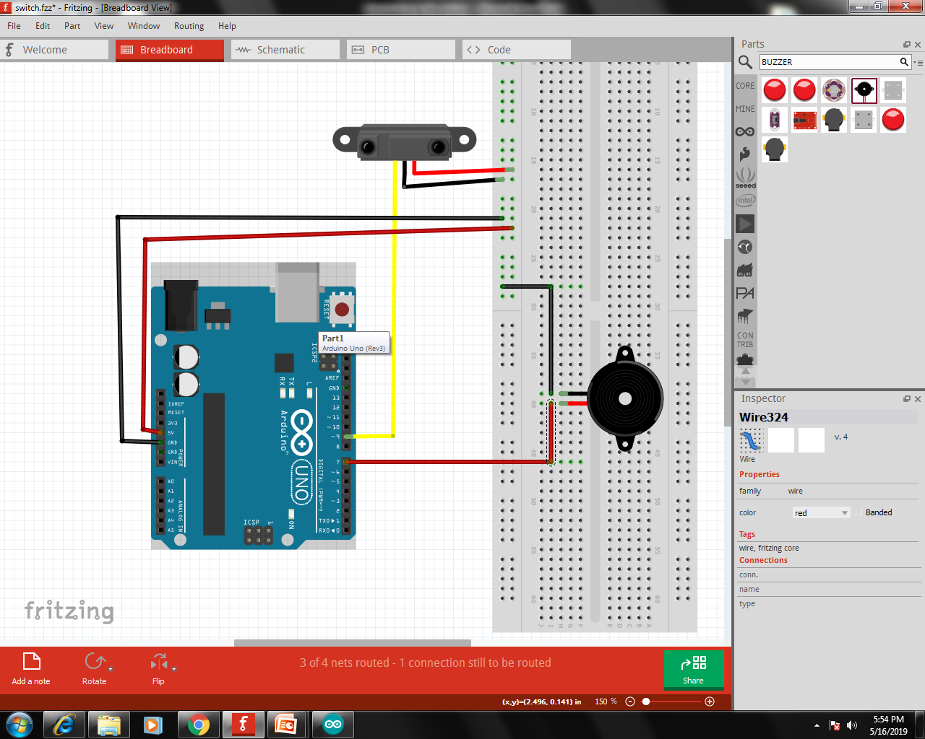

Slide 23
Communication
Basically Communication is of Two Types:
Parallel Communication.
Serial Communication.
Parallel Communication:
Parallel communication is the process of sending/receiving multiple data bits at a time through parallel channels. It is like you are firing using a shotgun to a target. where multiple bullets are fired from the same gun at a time!
Serial Communication:
In Telecommunication and Computer Science, serial communication is the process of sending/receiving data in one bit at a time. It is like you are firing bullets from a machine gun to a target… that’s one bullet at a time!

Slide 24
Parallel v/s Serial Communication
Serial Communication | Parallel Communication
One data bit is transceiver at a time | Multiple data bits are transceiver at a time
Slower | Faster
Less number of cables required to transmit | Higher number of cables required

Slide 25
Types of Serial Communication
Simplex:
In this mode of serial communication, data can only be transferred from transmitter to receiver and not vice versa.
Half Duplex:
this means that data transmission can occur in only one direction at a time, i.e. either from master to slave, or slave to master, but not both.
Full Duplex:
full duplex communication means that data can be transmitted from the master to the slave, and from slave to the master as the same time!

Slide 26
Baud Rate:
The baud rate is the rate at which information is transferred in a communication channel. In the serial port context, "9600 baud" means that the serial port is capable of transferring a maximum of 9600 bits per second.
Serial Communication
UART USART
Bluetooth , GSM SPI, I2C

Slide 27
UART and USART
UART stands for Universal Asynchronous Receiver Transmitter, whereas USART stands for Universal Synchronous Asynchronous Receiver Transmitter. They are basically just a piece of computer hardware that converts parallel data into serial data. The only difference between them is that UART supports only asynchronous mode, whereas USART supports both asynchronous and synchronous modes. Unlike Ethernet, Firewire etc., there is no specific port for UART/USART. They are commonly used in conjugation with protocols like RS-232, RS-434 etc. (we have specific ports for these two!).

Slide 28
Code for receiving a Character
Char c;
Void setup()
{
serial.begin(9600);
}
Void loop()
{
While(serial.available()>0)
{
C=serial.read();
}
}

Slide 29
Code for transmitting a Character
Char c;
Void setup()
{
serial.begin(9600);
}
Void loop()
{
While(serial.available()>0)
{
C=serial.read();
Serila.print(c);
}
}

Slide 30
Code for transmitting a string
String str;
Void setup()
{
serial.begin(9600);
}
Void loop()
{
While(serial.available()>0)
{
C=serial.read();
str+=c;
Serila.print(str);
}
}

Slide 31
Code for receiving a string
String str;
Void setup()
{
serial.begin(9600);
}
Void loop()
{
While(serial.available()>0)
{
C=serial.read();
str+=c;
}
}

Slide 32
Interfacing I/O program with serial communication
int ir;
Void setup()
{
serial.begin(9600);
pinMode(9,INPUT);
}
Void loop()
{
Ir=serial.read();
If(ir==HIGH)
{
serial.print(IR Activated);
}
Else
{
serial.print(IR De-activated);
}
}

Slide 33
Introduction to LCD
LCD (Liquid Crystal Display) screen is an electronic display module and find a wide range of applications. A 16x2 LCD display is very basic module and is very commonly used in various devices and circuits. These modules are preferred over seven segments and other multi segment LEDs.
A 16x2 LCD means it can display 16 characters per line and there are 2 such lines. In this LCD each character is displayed in 5x7 pixel matrix. This LCD has two registers, namely, Command and Data.
A command is an instruction given to LCD to do a predefined task like initializing it, clearing its screen, setting the cursor position, controlling display etc. The data register stores the data to be displayed on the LCD. The data is the ASCII value of the character to be displayed on the LCD. Click to learn more about internal structure of a LCD.

Slide 34
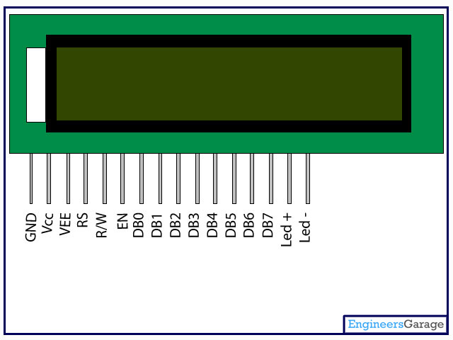
Pin Diagram:
Pin Description:
Pin No | Function | Name
1 | Ground (0V) | Ground
2 | Supply voltage; 5V (4.7V – 5.3V) | Vcc
3 | Contrast adjustment; through a variable resistor | V_{EE}
4 | Selects command register when low; and data register when high | Register Select
5 | Low to write to the register; High to read from the register | Read/write
6 | Sends data to data pins when a high to low pulse is given | Enable
7 | 8-bit data pins | DB0
8 |  | DB1
9 |  | DB2
10 |  | DB3
11 |  | DB4
12 |  | DB5
13 |  | DB6
14 |  | DB7
15 | Backlight V_{CC} (5V) | Led+
16 | Backlight Ground (0V) | Led-

Slide 35
Code to display data on lcd
#include<liquidCrystal.h>
LiquidCrystal lcd(12,11,5,4,3,2);
Void setup()
{
lcd.begin(16,2);
}
Void loop()
{
lcd.clear();
lcd.Setcursor(0,0);
lcd.print(“hai”);
}

Slide 36
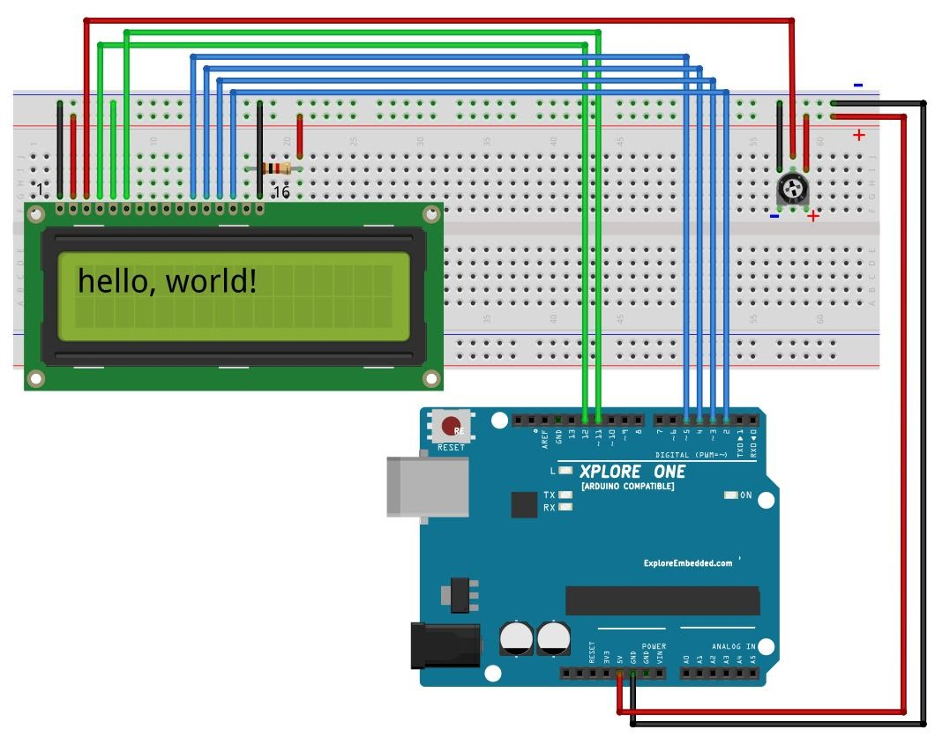

Slide 37
Introduction to the Project
Voice controlled home automation:
Technology advancements have made the implementation of embedded systems within home appliances. This increased the capabilities and features. There is demand for smart home automation through mobile phones. Bluetooth modules are cost effective and flexible so it is one of the best choices for smart home automation. This paper presents a novel technology where the user controls the devices through mobiles. Implementation is done using as a controller to which the devices are directly interfaced. Control to the devices is communicated to the mobile phone using speech recognition technique.

Slide 38
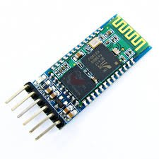
Introduction to Bluetooth
Bluetooth is a standard used in links of radio of short scope, destined to replace wired connections between electronic devices like cellular telephones, Personal Digital Assistants (PDA), computers, and many other devices. Bluetooth technology can be used at home, in the office, in the car, etc. This technology allows to the users instantaneous connections of voice and information between several devices in real time. The way of transmission used assures protection against interferences and safety in the sending of information.
Every device will have to be equipped with a microchip (transceiver) that transmits and receives in the frequency of 2.4 GHz that is available in the whole world (with some variations of bandwidth in different countries). Besides the information, there are three channels of voice available.

Slide 39
Hardware Requirements
Power Supply
Relay Boards
Bluetooth(Hc-05)
LCD
Controller
Connecting Wires

Slide 40
Software Requirements
Arduino IDE
Embedded C
Code Development
Compilation
Getting Results

Slide 41
Any Queries??

Slide 42
Thank you!!!

